Slide 1
Online Municipal Portal
AED Final Project
R.V.Rishik

Slide 2
Problem Statement
City governments often have failed to ensure that the whole range of the city's services :Pollution Control, Waste management and Parking system are in good condition
The population has increased over the past two decades and its economy has developed tremendously, brought about an unprecedented increase in the amount of solid waste and pollution.

Slide 3
Problem Solution
Providing Sensors around the city to control Pollution and Waste.
Proper Tracking System For Waste Management.
Providing Parking Lots to the people of the city by collecting details and generating ticket for them.
Recycling the waste by taking the information from Waste Control Admin

Slide 4
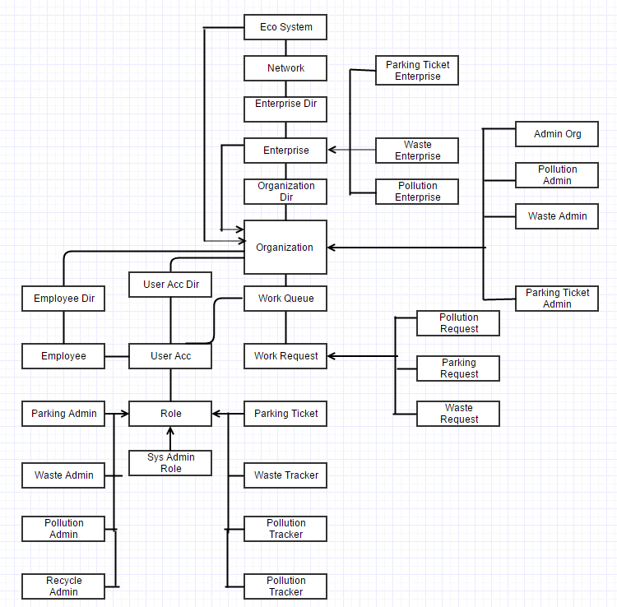
Object Model:

Slide 5
Key Roles
Parking Enterprise Admin-Parking Control Admin-Parking Officer
Pollution Tracker-Pollution Control Admin.
Waste Tracker-Waste Control Admin-Recycle Admin-Recycle Worker

Slide 6
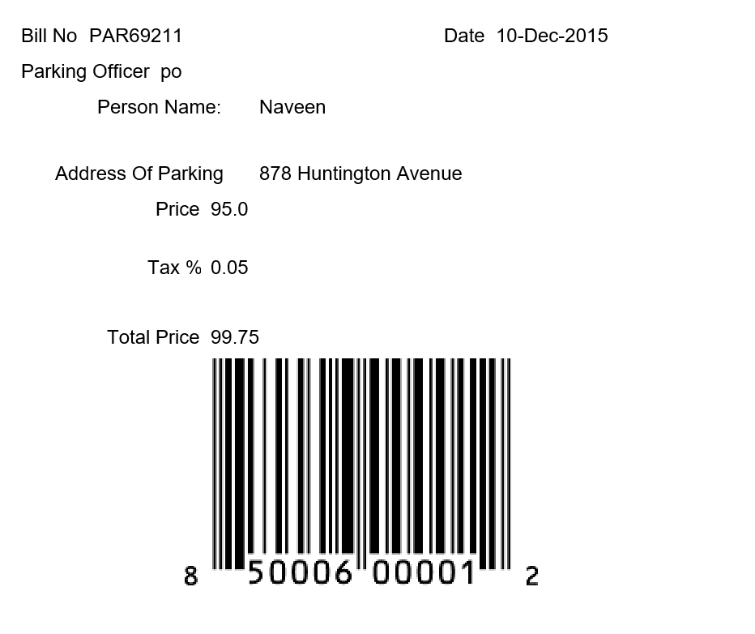
Key Features

Slide 7
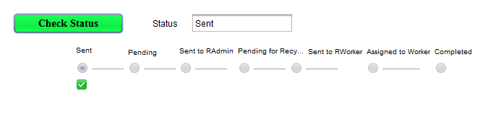
Waste Tracking System

Slide 8
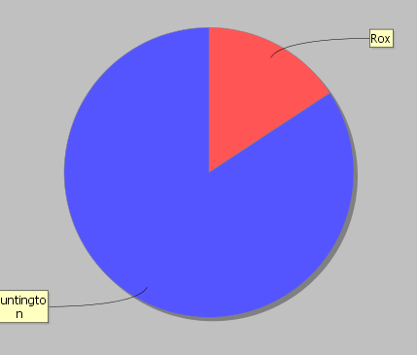
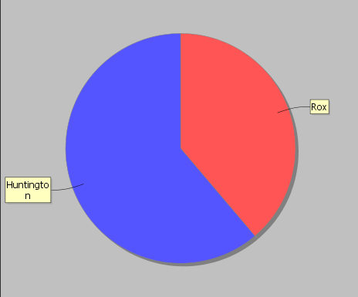
Pollution Analytics:
Co2 Comparison Per Area
CO Comparison Per Area

Slide 9
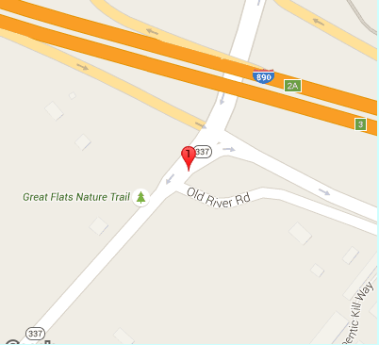
Parking Lot Location With Map

Slide 10
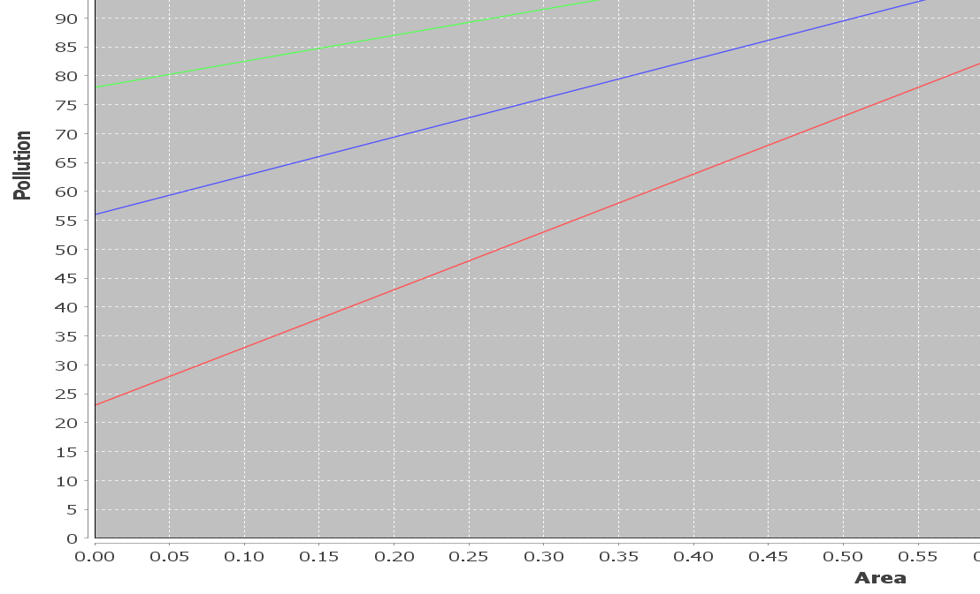
Pollution Vs Area Graph

Slide 11
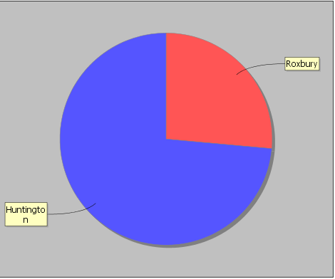
Waste Analytics

